Slide 1
Understanding Design Problems
CP1403
Design Thinking

Slide 2
Topics
What is design challenge & design innovation?
The Design Thinking Process- Empathy
Understanding the Problem
Observing Users
Design Thinking Methods for Empathy
Primary Research
Observe & Engage: What? How? Why?, User camera study, Interview for Empathy
Immerse: Immersion & Guided Tour

Slide 3
Readings
SPRINT Chapter 1??
What is Design Innovation by Tim Brown http://www.designinnovation.ie/what_innovation_sec1.html

Slide 4
Before Lecture
Observe the functions and controls of 5 appliances at home
Observe how people using the appliances and devices at home
Make notes, take photos, draw sketches about the observations

Slide 5
Activity (10 minutes)
Form a group of 5 students
Share your experience and interesting findings from observing how people interaction with appliances and devices at home.

Slide 6
What is a design challenge ?

Slide 7
Design Challenge
Every design process begins with a broad design challenge
aims to create a specific design innovation
Opportunities for design innovation often begins by noticing problems.
Sometimes it comes out as wishes (Dream list)
“I really wish I had a single remote controller for all appliances .”
Sometimes it comes out as complaints (Gripes list)
“It annoys me that there are so many different remote controllers for different appliances at home.”

Slide 8
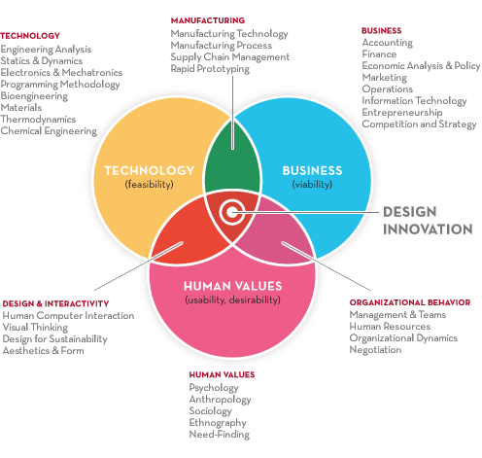
Design Innovation
Innovation is driven by three forces:
Business investigates the viability of new products or services;
Technology explores the feasibility of new products or services;
People judge the desirability and usability of new products or services.
References: http://www.designinnovation.ie/what_innovation_sec1.html
Notes:
Innovation is driven by three forces: business, technology and people.
Business investigates the viability of new products or services;
Technology explores the feasibility of new products or services;
People judge the desirability and usability of new products or services.

Slide 9
Example of broad design challenge
Design a smarter home to provide insights for managing personal life or the household.

Slide 10
Understanding the broad design challenge and observing users
(Empathy)

Slide 11
“Directly witnessing and experiencing aspects of behavior in the real world is a proven way of inspiring and informing[new] ideas.
The insights that emerge from careful observation of peoples behavior[…] uncover all kinds of opportunities that were not previously evident”
Jane Fulton Suri (2005)
http://www.thoughtlessacts.com

Slide 12
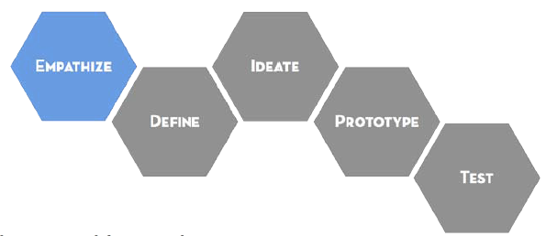
Empathy
Empathy is the foundation for building a meaningful design solution.
Understand the broad design challenge
Research and gather inspiration

Slide 13
Empathy Understand the broad design challenge
State the broad design challenge
E.g. Design a smarter home enabled by sensors, mobile and connectivity technologies.
Identify what you already know
I know that GE has an oven with WiFi connectivity
I know that some TV have motion sensor to turn off the TV when no user motion is detected
I know that there are some devices providing information about energy consumption
Identify what you want to know more
I want to know more about how different people use an oven
I want to know more about the different selection criteria different people use when purchasing a TV

Slide 14
Activity (10 minutes)
Form a group of 5 students
Share what you already know about the broad design challenge : Design an application/device to provide insights for managing personal health and wellbeing.

Slide 15
Empathy Research and gather inspiration
Empathy can reveal thoughts and values which are not obvious to the people who hold them
Good designs are built on a solid understanding of users’ beliefs and values.
Research and gathering inspiration allows designers to:
Uncover needs that people have which they may or may not be aware of
Guide innovation efforts
Identify the right users to design for
Discover the emotions that guide behaviors

Slide 16
Empathy Methods Research and gather inspiration
Primary Research:
Observe:
what users do/say/express ?
Engage:
what users think/value/believe/need/feel?
User camera study
Interview for Empathy
Immerse:
immersion
guided tour

Slide 17
Empathy Methods What? How? Why?
It is a tool to help you drive deeper into your observation, often used to analyse photos taken during an observation session
Move from mere observations to more abstract examination of beliefs and emotions.
To find the needs of the users
To reveal assumptions that you may need to verify with users during interview

Slide 18
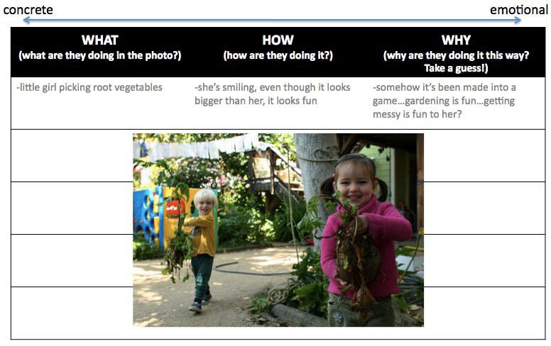
Empathy Methods What? How? Why?

Slide 19
Empathy Methods User camera study
User camera study asks users to take photos of their experiences.
It allows designer to understand users’ lives and specific task within the context.

Slide 20
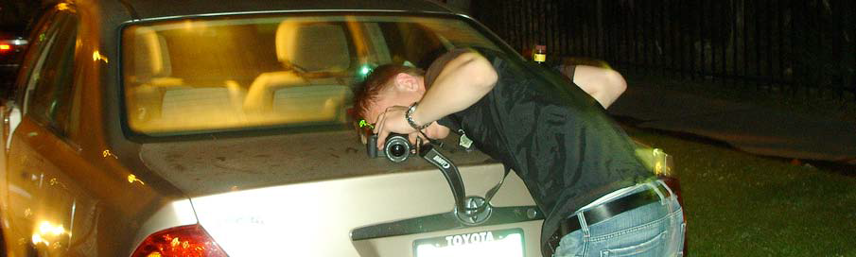
Empathy Methods User camera study

Slide 21
Empathy Methods User camera study steps
Identify users who are related to the design challenge
Explain the purpose of the study to the users and ask if they are willing to take photos of their experiences.
Provide a camera to the user and instruct them about what you would like them to take. For example:
“Please document your morning routine experience with this camera.”
“Take pictures of things that are meaningful to you in your kitchen.”

Slide 22
Empathy Methods User camera study Steps
Afterwards, ask the users to walk you through the taken photos and explain the significance of what they captured.
Initially allow them to drive the explanation, then dig deeper with questions if needed
“Why did you photograph this particular item?”
“Is this part of your routine fun/enjoyable?”

Slide 23
Empathy Methods User camera study Steps
You can dive deeper and use the “Interview for Empathy” technique to understand more about the users.

Slide 24
Empathy Methods Interview for Empathy
Interview for Empathy is used to understand a person’s thoughts, emotions and motivations so that you can design an innovation for him or her.
Time to interview with users is precious.
You will need good preparation before actually interviewing the users.

Slide 25
Activity (5 minutes)
Watch this video for some examples of good and bad interview questions
Good and bad examples of interview
https://youtu.be/Cl9vMBFHIf0

Slide 26
Empathy Methods Interview for Empathy Preparation
Brainstorm and write down all potential questions and try to group them into meaningful subject areas
Identify the importance of each subject area and try to arrange the questions to allow the conversation to flow most naturally
Also condense/combine questions where possible

Slide 27
Empathy Methods Interview for Empathy
After grouping and ordering the questions, check that you have leave room to ask plenty of questions:
“Why?”
“Tell me about the last time you__?”
other questions that directed at how the user feels.
Always rehearse the interview with your team members before interviewing the users.

Slide 28
Empathy Methods Interview for Empathy (How to)
Ask why, even when (and especially if) you think you know the answer
Never say “usually” when asking a question, ask about a specific instance/event
Look for inconsistencies, these often hide interesting insights

Slide 29
Empathy Methods Interview for Empathy (How to)
Encourage users to tell stories by asking the users
Tell me about the last time …..
Yes, and ….
5 Whys
Tell me more
What do you mean by …..
How are you dealing with the problem now ?
References: https://youtu.be/2RBsXQYRUUM

Slide 30
Empathy Methods Interview for Empathy (How to)
Pay attention to nonverbal cues, body language and emotions
Don’t be afraid of silence, give time to users to reflect and think about what they want to say
Don’t suggest answers to your questions
Ask questions neutrally and don’t ask binary (Yes/No) questions

Slide 31
Empathy Methods Interview for Empathy (How to)
Make sure you observe and capture the interview
Always interview in pairs and have each member of the pair capture notes of the interview
The interviewer may not able to capture notes as detailed as the observer, so compare notes after the interview
You may also use voice recorder/video recorder (with permission)

Slide 32
Empathy Methods Guidelines for Good Interview Questions
Avoid closed questions.
Closed questions are typically questions that yield dead-end answers.
Are you happy with ____? Do you dislike _____?
How do you think _____ should look? How often do you use ______?
Do you think _____ is better than _____?
Inevitably, closed questions will come up in the natural flow of conversation
it’s almost impossible to never ask a closed question
You can recover by simply asking your participant “Why? ...”

Slide 33
Empathy Methods Guidelines for Good Interview Questions
Avoid leading questions.
Leading questions tend to be directional in that they close off alternative and potentially undesirable answers.
Leading questions typically end with speech like “isn’t it?” “am I right?” or “don’t you think?”
Some examples of leading questions are
____ is better than _____, don’t you think?
Would _____ be easier to click if it were bigger?
Is it true that you are more productive when you ______?

Slide 34
Empathy Methods Guidelines for Good Interview Questions
Use open-ended questions to promote thoughtful answers and typically motivate participants to share the unique aspects of their activities.
Some examples of open questions are
Can you walk me though a typical work day?
After you’ve completed ______, what do you with the results?
Describe the benefits of ______?
What are you thinking while you are performing ______?
How would you describe ______ to a friend?
When _____ doesn’t work, how do you work around it?
Do you have any “tips and tricks” for using _____?
What do you like best about _____?
What do you dislike about _____?

Slide 35
Empathy Methods Interview Note
Take constant notes during interview
Answers to questions
Body-language cues
General observations
Questions for follow up
Condense this into Interview Insights

Slide 36
Empathy Methods Interview Insights
Interview Date:
Interview Time:
Personal details: who did you meet (profession, age, location, etc)?
Interesting stories: what was the most memorable and surprising story?
Motivations: what did this participant care about the most? What motivates him/her?
Frustrations: what frustrated him/her?
Interactions: what was interesting about the way he/she interacted with his/her environment?
Remaining Questions: what questions would you like to explore in your next conversation or in other interviews?

Slide 37
Reading Body Language
Look for non-verbal cues to identify participants emotional state
Are they happy/sad/excited?
Use http://www.bodylanguagesignals.com/how-to-read-body-language-2.html as a resource for identifying different cues/signals
Never make assumptions based on a single cue
Look for several signs of similar emotional states
ALWAYS be aware of the context
E.g. if you are interviewing people about a stressful experience (e.g. moving house) then don’t be surprised if they exhibit signs of stress ☺

Slide 38
Post-Interview processes
Once you have interviewed several participants it’s time to look for trends
What words, or themes, were common to most/all participants?
What was unique to just one or two?
What body-language did you observe?
These trends may require further information to be uncovered
Follow up interviews, focus groups etc.

Slide 39
Empathy Methods Immersion
Immersing yourself in the lives and communities of the people you are designing for.
Spend a day shadowing them, have they walk you through how they make decisions, observe them as they cook, socialize, relax…whatever is relevant to your design challenge

Slide 40
Empathy Methods Guided Tour
Taking a guided tour through the home or workplace of the user can reveal their habits and values
Ask questions about the user’s habits and space.
Why does he/she do the things he/she does?
Who uses the space?
Where are things kept?
Why are things organised the way that they are ?

Slide 41
Empathy Methods Research and gather inspiration
Secondary research
what are some recent news/innovations/solutions in the field ?
what is the current state of R&D in the field

Slide 42
Empathy Methods Secondary research
Secondary research is used to get yourself up to speed in the field related to the design challenge
Get to know the recent news about the field using internet, newspapers, magazines, or professional journals.
Try to understand recent innovations, understanding the edges of what’s possible.
Get inspirations from other solutions, use it to cross-check the interviews results (interview could be highly subjective)

Slide 43
Before Next Lecture
Watch Video How design thinking transformed Airbnb from failing startup to billion-dollar business https://youtu.be/RUEjYswwWPY
Write down 5 key points about design thinking is used by Airbnb

